Slide 1
Big Mountain Ticket Pricing
A data driven analysis by Jacob Getz

Slide 2
What’s the problem
Big Mountain Resort recently added a new chair lift which has upped operating costs. Up to this point they have been setting their prices based on a premium price when compared to the average price of resorts in its market segment. Its market segment is wide ranging and so there is suspicion that Big Mountain Resort isn’t capitalizing on their facilities as they compare to the rest of the market.
How can Big Mountain Resort set a ticket price for the upcoming season that more closely matches resorts in their market segment with similar facilities?

Slide 3
What does success look like?
Big Mountain Resort’s new ticket price maintains profit margins
Analysis is done in time for ticket pre-sales for the upcoming season

Slide 4
Our recommendations
Currently, Big Mountain resort is charging 81 dollars. Our modeling suggests that this is under the sustainable ticket price. Our model suggests the resort should be able to maintain a ticket price of 95 dollars.
If management is interested in investing more into the resort to further increase ticket price, we would recommend adding an additional run, increasing vertical drop distance by 150 feet, and adding an additional chair lift. With these actions we would expect to see a supported price increase of 1.99 per ticket, resulting in an estimated 3,474,638.00 dollars in increased revenue.

Slide 5
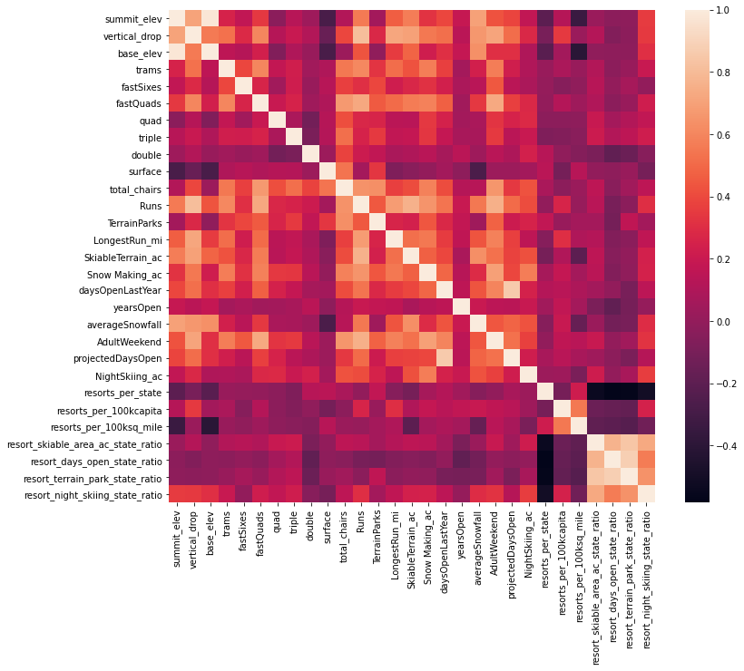
Heatmap of traits.
Initial high level exploration, modeled with the heatmap on the left, suggest that many of our traits have relatively low correlation to ticket price, including all the state specific traits. We remove the state specific traits and perform our more granular analysis on a better trained model.

Slide 6
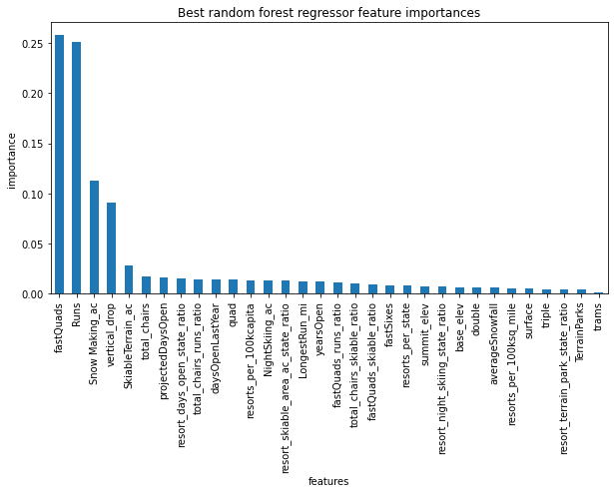
Trait Importance
After developing and training our model, we found trait importance expressed in the bar graph on the right. Clearly number of fast quads and runs make the largest impact with vertical drop and acres of snow making coming in third and fourth.

Slide 7
Conclusion
The simplest strategy to implement is increasing ticket prices to 95 dollars, this action is the least intrusive to resort operations. Depending on resort goals, we have 2 other directions we would recommend going. If management is interested in investing more into the resort to further increase ticket price, we would recommend adding an additional run, increasing vertical drop distance by 150 feet, and adding an additional chair lift. With these actions we would expect to see a supported price increase of 1.99 per ticket, resulting in an estimated 3,474,638.00 dollars in increased revenue. Alternatively, if management is interested in closing down runs, shutting down one run makes no difference in expected ticket price, shutting down both 2 and 3 runs see a slight decrease in supported ticket price, though once we make a 3 run closure decrease closing 4 and 5 see no further decrease. We would not advise closing more than 5 runs at this time as we would see a sharper drop off in expected revenue.

